Slide 1
HAND GESTURE DETECTION AND RECOGNITION
GROUP 63 REVIEW 3
Guide name
Dr.Komarasamy G

Slide 2
Contents
Abstract
Objectives​
Introduction​
Literature Work
Existing Work
Proposed Work​
System Flow Diagram​
Hardware/Software​
Experimental Results​
Conclusion and future work​
Reference
Contribution

Slide 3
Abstract
Hand gesture recognition is a technology that uses computer vision techniques to detect and interpret hand gestures made by a person.
These gestures can be used as a form of non-verbal communication and input for various types of systems, such as human-computer interaction, sign language recognition, and gaming.
A typical hand gesture recognition system includes a camera or depth sensor to capture the image or depth data of the hand.
The system can be trained using machine learning algorithms with a dataset of labeled hand gestures.

Slide 4
Objectives
Human-computer interaction: The system should allow users to interact with computers and other electronic devices using hand gestures, making the interaction more natural and intuitive.
Sign language recognition: The system should be able to recognize and interpret sign language gestures, allowing for more effective communication with people who are deaf or hard of hearing.
Gaming: The system should be able to recognize and respond to hand gestures made by players, allowing for more immersive and interactive gaming experiences.
Virtual reality: The system should be able to recognize and respond to hand gestures made by users, allowing for more realistic and intuitive interaction in virtual environments.

Slide 5
Introduction
Hand gesture recognition a wide range of applications, such as human-computer interaction, gaming, virtual reality, sign language recognition, and robotics.
One of the main issues in the area of hand gesture recognition is the variability of hand gestures.
Different individuals may make similar gestures with slight variations, making it difficult for the system to accurately recognize them.
Additionally, variations in lighting conditions, hand shape, and skin color can also affect the performance of the system.

Slide 6
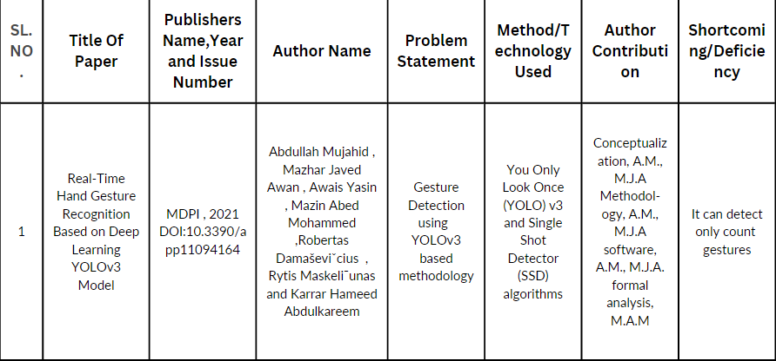
Literature Work

Slide 7
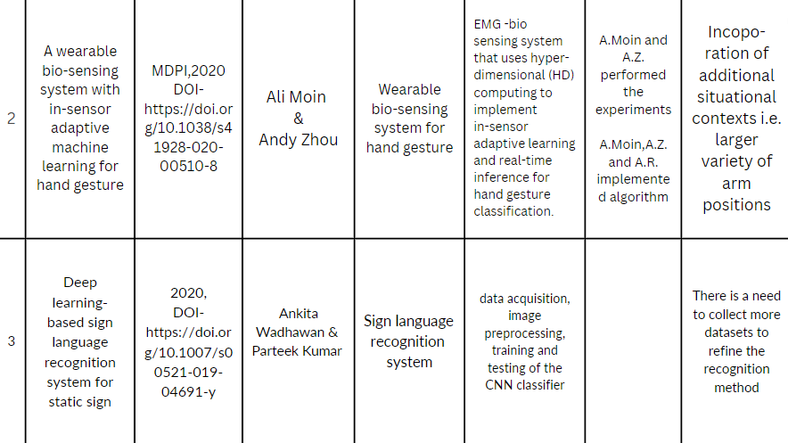

Slide 8
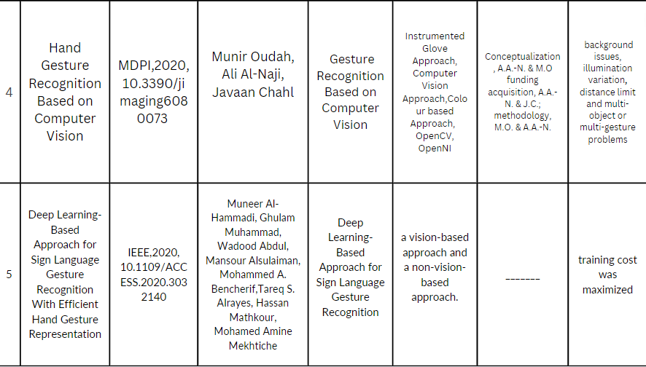

Slide 9
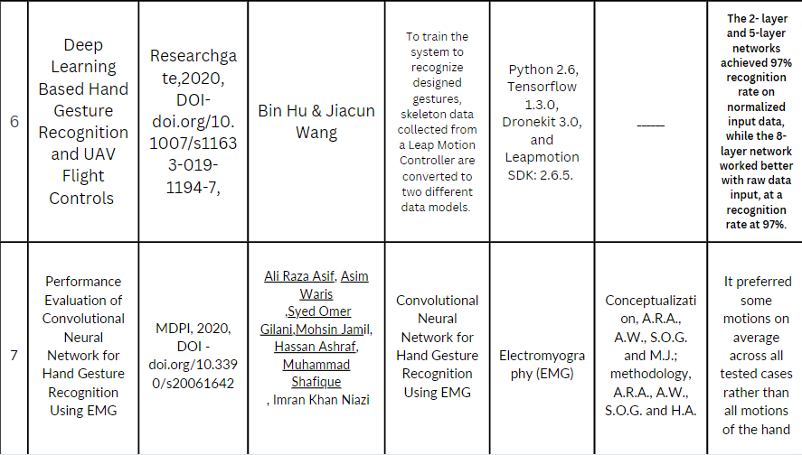

Slide 10
Existing work
There has been significant work on hand gesture recognition using deep learning in recent years.
Researchers have used various architectures such as convolutional neural networks (CNNs), long short-term memory (LSTM) networks, and combination of CNNs and LSTM networks for this task.
Many of the recent works have used depth data from depth sensors like Kinect and Leap Motion to train these models.
Additionally, some works have used data from RGB cameras and other modalities like infrared and thermal cameras to improve the robustness of the models.

Slide 11
Research Gap
Real-time performance
Multimodal data
Cross-database generalization
Cross-cultural and cross-lingual generalization
Complex gesture recognition
Robustness

Slide 12
Proposed work
Objective Statement:- To build hand gesture recognition system using deep learning.
Uniqueness it could be trained on a diverse dataset that contains different hand shapes and skin tones to improve the recognition rate for people with different hand characteristics.
The modules for hand gesture recognition using deep learning are:
Data acquisition: This module captures images of hand gestures using a depth sensor or an RGB camera. The images are labeled according to the gesture they represent.
Data preprocessing: This module preprocesses the images to align the depth and RGB images, resize them to the appropriate size, and normalize the pixel values.

Slide 13
Feature extraction: This module uses a convolutional neural network (CNN) to extract features from both the depth and RGB images. The CNN has two branches, one for the depth images and one for the RGB images.
Gesture recognition: This module uses a long short-term memory (LSTM) network to recognize the gestures based on the features extracted by the CNN. The LSTM network is trained to recognize the gestures.
Evaluation: This module evaluates the performance of the model using metrics such as accuracy, precision, recall, and F1-score.
Deployment: This module deploys the model on a device with a depth sensor or RGB camera for real-time gesture recognition.

Slide 14
The algorithm used in the hand gesture recognition system using deep learning s a combination of two main algorithms:
Convolutional Neural Network (CNN)
Long Short-term Memory (LSTM) network
The CNN extracts the features from the depth and RGB images and the LSTM network uses those features to recognize the gesture. The combination of CNN and LSTM can be effective in recognizing complex dynamic hand gestures.

Slide 15
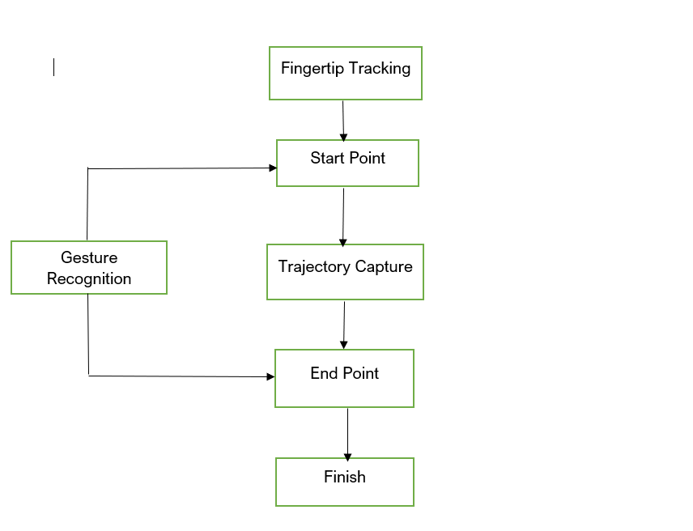
System Flow diagram

Slide 16
Data acquisition: The system captures images or video of the user's hands using a camera or other input device.
Preprocessing: The images or video are preprocessed to remove noise and enhance the features of the hand gestures. This may include image cropping, normalization, and background subtraction.
Feature extraction: The system extracts features from the preprocessed images or video that are relevant for hand gesture recognition. This may include extracting the shape, size, and movement of the hand.
Classification: The system uses the extracted features to classify the hand gestures. This may include training a machine learning model on a dataset of labeled hand gestures.
Output: The system generates an output based on the recognized hand gesture. This may include controlling a cursor on a screen, or sending commands to another device.
Feedback & Evaluation: Depending on the specific application, the system may be able to provide feedback to the user, or be evaluated against a set of ground truth samples, to improve its recognition accuracy over time.

Slide 17
Software used
Software and Hardware details with Justification
S.No | Software used | Justification
1. | Python | Programming Language
S.No | Modules used | Justification
1. | TensorFlow | For Machine Learning
2. | Numpy | Data Preprocessing
3. | OpenCV | Data and image capture
4. | Matplotlib.pyplot | To Create Plots and Charts
S.No | Hardware used
1. | Processor: i3, i5,i7
2. | RAM: 4GB,8GB
3. | Hard disk: 16GB
4. | Web Cam

Slide 18
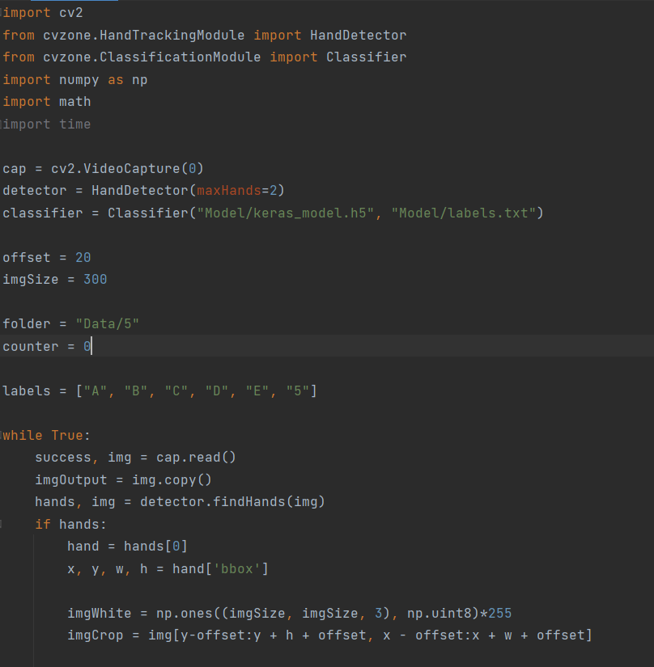
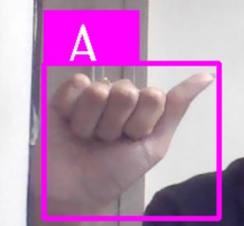
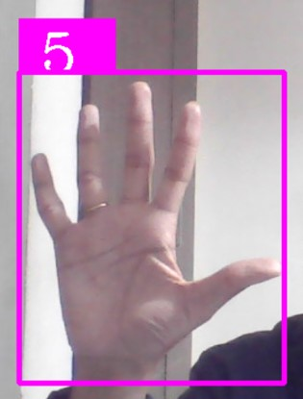
Experimental results

Slide 19
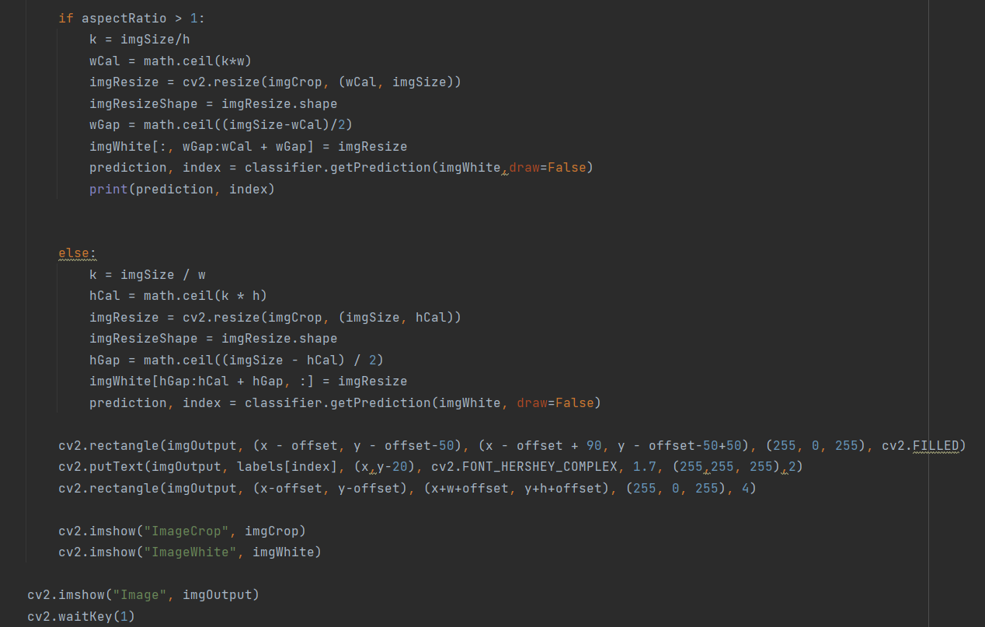
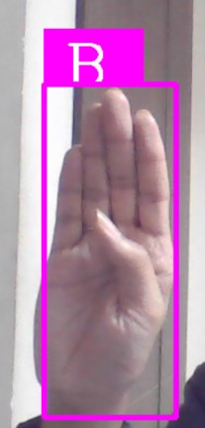
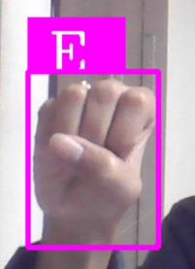

Slide 20
Conclusion and future work
There are people who are deaf who uses hand sign to convey their message but normal people some time might know sign language
Individuals who are using hand signs to communicate covertly or to trigger certain actions.
Sometime it is difficult for audience and players to interpret hand signals used by coaches and players to communicate during games.

Slide 21
Reference
Paper 1 , Abdullah Mujahid , Real-Time Hand Gesture Recognition Based on Deep Learning YOLO v3 Model , (MDPI , DOI:10.3390/app11094164,
Year of publication 2021)
Paper 2 , Ali Moin , A wearable bio-sensing system with in-sensor adaptive machine learning for hand gesture , (MDPI , DOI-https://doi.org/10.1038/s41928-020-00510-8 , Year of publication 2021)
Paper 3 , Ankita Wadhawan , Deep learning-based sign language recognition system for static sign , (DOI-https://doi.org/10.1007/s00521-019-04691-y , Year of publication 2021)
Paper 4, Munir Oudah , Hand Gesture Recognition Based on Computer Vision , ( MDPI , 10.3390/jimaging6080073 , Year of publication 2020)

Slide 22
Paper 5 , Muneer Al-Hammadi , Deep Learning-Based Approach for Sign Language Gesture Recognition With Efficient Hand Gesture Representation , ( IEEE, 10.1109/ACCESS.2020.3032140 , Year of publication 2020)
Paper 6 , Bin Hu , Deep Learning Based Hand Gesture Recognition and UAV Flight Controls , ( Researchgate , DOI- doi.org/10.1007/s11633-019-1194-7, Year of publication 2020
Paper 7 , Ali Raza Asif , Performance Evaluation of Convolutional Neural Network for Hand Gesture Recognition Using EMG ,( MDPI , DOI - doi.org/10.3390/s20061642 , Year of publication 2020)

Slide 23
Contribution of all the members
Mention all the members with contribution
S.No. | Roll No | Name | Contribution
1 | 21BAI10168 | Nishant Seth | Content, Abstract,Objective, Introduction, Software Used,Code
2 | 21BAI10159 | Divya Agarwal | Existing work,Research gap,Problem statement,Proposed work
3 | 21BAI10247 | Shubham Singh | future scope ,conclusion and Reference
4 | 21BAI10116 | Aashish Yadav | Literature Work, System Flow Diagram
5 | 21BAI10047 | Ujjwal Sagar | Literature Work

